Slide 1

Introduction to GPS on a Procurement projects environment
Presented by:
Nilda Ramos October 18, 2019
Notes:
This is an example of a Title Slide. We need to convey Life Is On in everything we do, so try to lead with compelling images that are vibrant, authentic, and human. The human element should be apparent and within the context of a segment that we touch.
To keep this PowerPoint template file size reduced, we included a small library of image choices in the Slide Master (under View). You can also get them from the SE Asset Library: https://schneiderelectric.telescopeondemand.com

Slide 2
Agenda
1
What is GPS
2
Global PMO- Overview
3
Templates on GPS
4
Extra (and useful) templates
5
Live Demo
6
How to migrate to PPT?
Notes:
Agenda slide

Slide 3
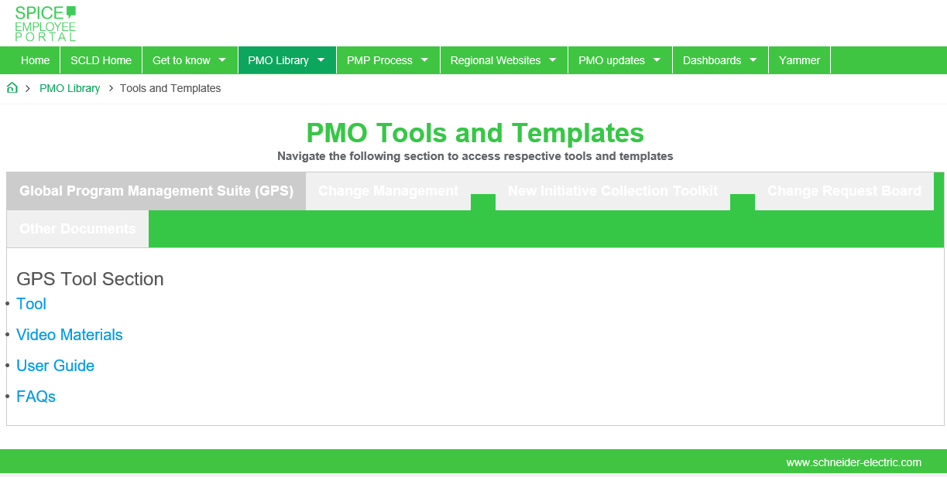
What is GPS?
…Or Global Program Management Suite
Is a tool that helps you save time and simply apply project management best practices. It gives you a uniform easy format to plan, execute provide visibility to your project, with some great features such as automated reports.
This tool has been developed by the Global PMO team, and can be downloaded from the PMO Library in the following link: https://spiceportal.se.com/web/program-management-office/templates-right2
Notes:
This is an example of a Text Slide. Reference the different layout options in the Slide Master (under the View tab) for different variations. Remember, our new Brand Guidelines call for clean and simple messages and design. Reference the PowerPoint Guidelines on the Brand Book for tips and useful information on creating effective presentations.

Slide 4

Global Program Management Suite (GPS) Overview
AREA
Integration Management
Scope Management
Time Management
Risk Management
Cost Management
Resources Management
Stakeholder Management
Quality Management
Mandatory
Project Charter
Status Report
Project Finance
Resource Plan
Recommended
Decision Log
Project Schedule
Issues & Actions
Comms Plan
Lessons Learned
Risk Register
Optional
Change Request Log
Problem Statement
Business Cases
KPIs
Schneider Digital Addendum
Financial Tracking
Tracker
Minutes of Meeting
Business Requirements
GPS
Receive information from

Slide 5
Templates on GPS
To focus during this training
Structure
Charter
Project Schedule
Status Report
Resource Plan
It contains the key information of the project: objective, scope and deliverables, benefits, and also the assumptions: constraints and dependencies.
It is the start point and reference to measure the performance of the project.
Is used to guide the project execution and to track and control its progress.
The main objective is to document the tasks, action owners and time for each activity and facilitating the control of the project.
It shows the progress of the project and the reason of the status.
Identify all the resources and utilization of each one required to complete the project successfully,
Issues and Action Log
Risk Register
Contains a list of ongoing and closed issues and actions of the project..
Document in which the results of risk analysis and risk response planning are recorded

Slide 6
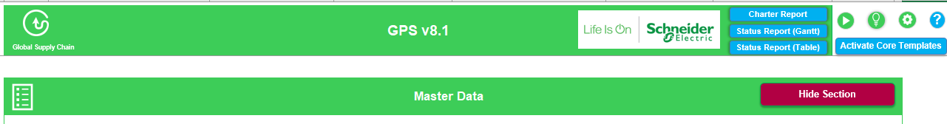
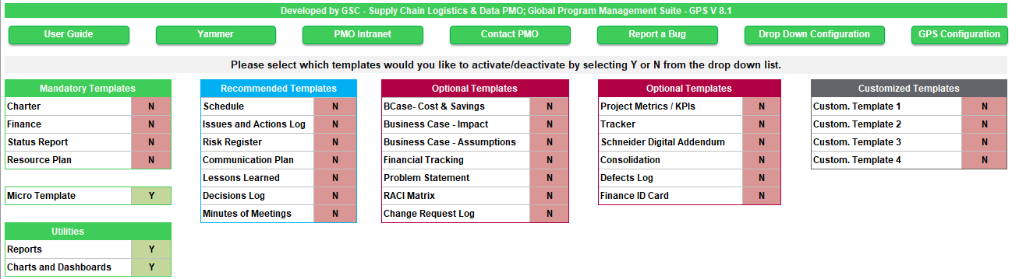
GPS Template version and settings
There is one only version of GPS and the user can activate the Templates they are interested in.
The Default Template of v8.1 will be the Micro Template and it is recommended only for small projects. However, the user can easily switch to the 4 core templates, by clicking the button “Activate Core Templates”
A
A

Slide 7
Charter
It contains the key information of the project: objective, scope and deliverables, benefits, and also the assumptions: constraints and dependencies.
It is the start point and reference to measure the performance of the project.

Slide 8

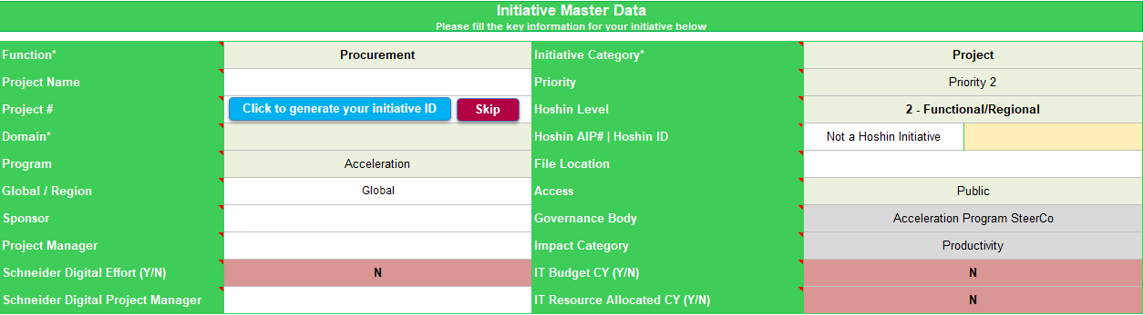
Charter
A
Do not name a project using these symbols
\ / : * ? < > |
Mandatory fields
F
D
A
B
D
As a suggestion, in the impact category, just put the most important/relevant customer impact.
C
If you start a new initiative, you can auto-generate the number of your initiative. You can click Skip, if you already know the number, if you want to create a draft file or if you want to add it manually later. This functionality communicates with the Database.
Choose the Program to use: Acceleration or SBO.
Select the type of restriction to information: Public or Restricted.
- Public access means that everyone that have access in the Box folder "Global SCLD Projects and Programs" can view your project information.
- Restricted projects with confidential information, will have their data in a separate Master list (List of Project Data) which will be visible only by a specific group of people in Box. By default, every project has a public access.
On File Location add the OTTO ID of your project
A
Q: My project doesn’t have a project number, can I assign this number? A: For Global project, please contact Global PMO. If it’s regional project, contact regional PMO.
B
?
C
D

Slide 9
Charter
Do not name a project using these symbols
\ / : * ? < > |
Mandatory fields
F
G
As a suggestion, in the impact category, just put the most important/relevant customer impact.
Select your project function. For this case, Procurement
Initiative category is another mandatory field. Project, Program (category management), or Pre-Study.
F
G

Slide 10
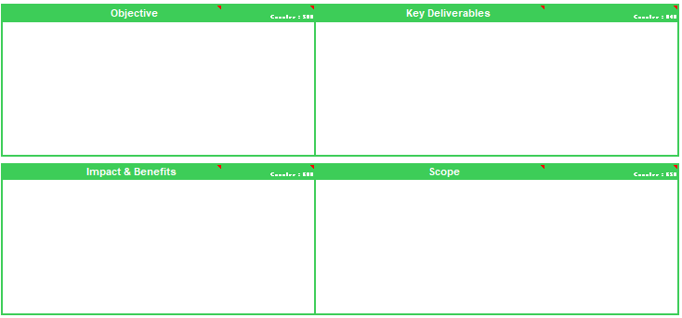
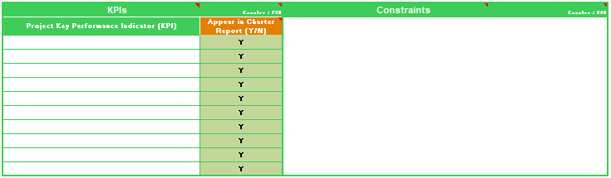
Charter
Key deliverables are “what is left at the end of the project”.
Example: animation of the project and assessment are not deliverables.
What is the reason of the initiative?
Something toward which work is to be directed, a strategic position to be attained, a purpose to be achieved, a result to be obtained, a product to be produced, or service to be performed.
Any measurable, tangible, verifiable outcome, result, or item that must be produced to complete a project or part of a
project/program (phase).
In the Key Deliverables field, the user can display the due date of those deliverables in PowerPoint.
In order to do that, please add a semicolon “;” after the deliverable and then enter the due date.
Format
Deliverable ; Due Date
e.g. Deliverable 1 ; Sep 2019
The objective must carry the organization from a troubled past to a future with benefits and value creation.
You can use the SMART methodology to define objectives for your project.
What will be the outcome, result or item that must be produced to complete the project?
The work that needs to be accomplished to deliver a product, service, or result with the specified features and functions.
The perimeter of the project: what
is related with it and what is out of
the project.
The key financial, service and other benefits of the project.
Defining what is NOT in the scope really helps defining the scope.
Key Performance Indicators to measure the success of the project.
An applicable restriction or limitation, either internal or external to the project that will affect the performance of the project or a process.
How you will measure the performance of the project?
What are the restrictions that will be affect the performance of the project?
e.g. Scope, schedule, cost, quality, etc

Slide 11
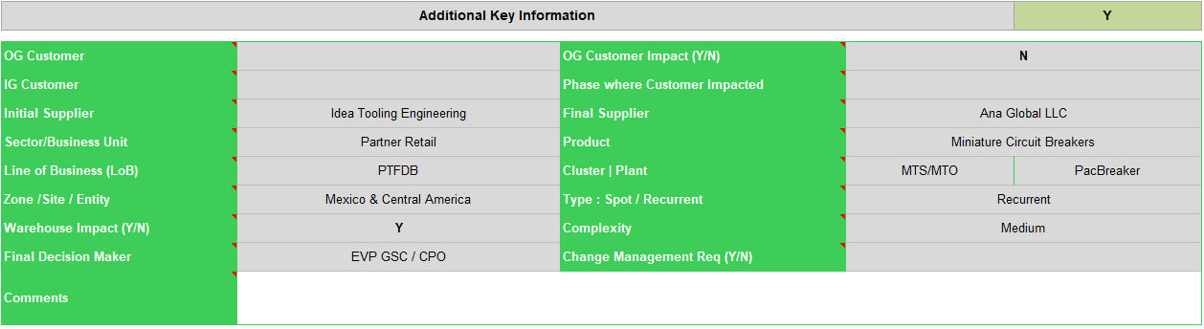
Charter
As it is optional, you may hide these fields by selecting “N”

Slide 12
Status Report
Document that involves the periodic collection and analysis of baseline versus actual data to understand and communicate the project progress and performance as well as to forecast the project results.

Slide 13
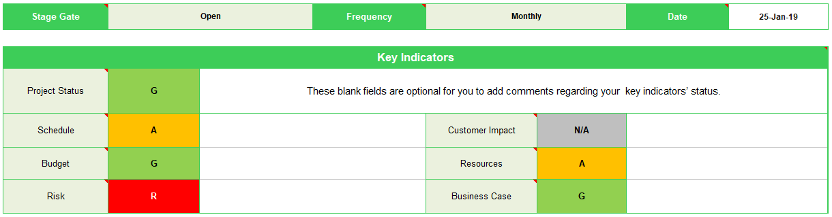

Status Report
Stage Gate, Frequency of Reporting and Key Indicators
A
B
Frequency can be different depending on the phase you are.
C
These fields are optional for you to add comments regarding your key indicators’ status.
A
Frequency : Specify how often are you going to update the initiative status. It can be weekly, bi-weekly, monthly, quarterly.
G
On schedule, on budget, low risk impact
A
Some delays, budget overrun, risks impacting project. Project ongoing
B
Stage Gate : According to your timeline and the PMP process, indicate the last stage gate that the project has passed. You can select among Prior to Open, Open, Select, Do, Implement, Produce, Sell, Close or the Schneider Digital Stage Gates
R
Significant schedule delays, budget concerns and/or risks. at risk of stopping.
B
Closed / Finished
G
Cancelled / Dropped
C
Indicate the Status of each category (e.g Schedule, Risk) and provide a short description
W
Not Started/Prior to OPEN
N/A
Not Applicable

Slide 14
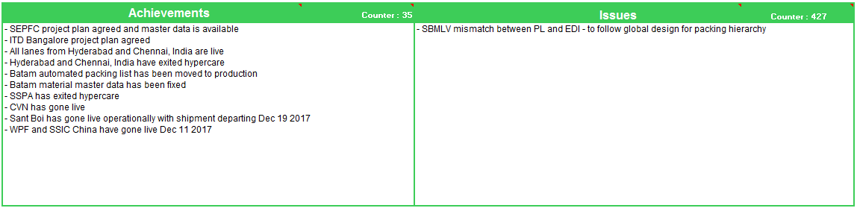
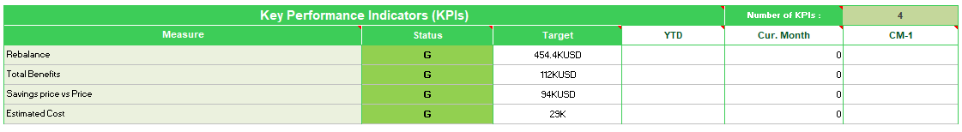
Status Report
Achievements, Issues, KPIs
A
B
C
A
Achievements : What are the key achievements of the project to date?
Insert the key achievements accumulated since the beginning of the project.
As you have a limited number of characters, you should select the best ones to appear in the report.
C
You can specify and track up to 6 KPIs in the status report. If you have more than 6 KPI, it is advised to use the KPI template.
You can customize the headers with the white background.
B
Issues: What are the issues identified that affect the project? – You can sync from the Issues and Actions Log*

Slide 15
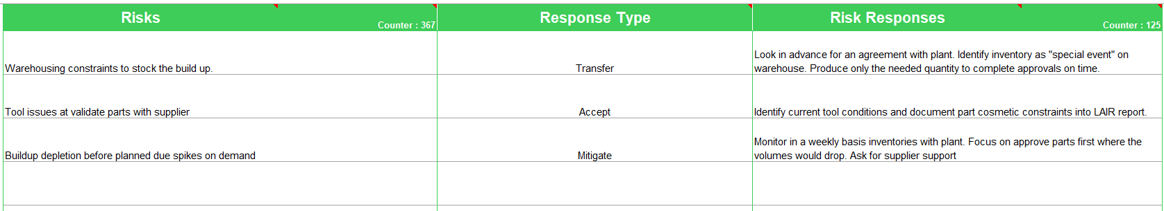
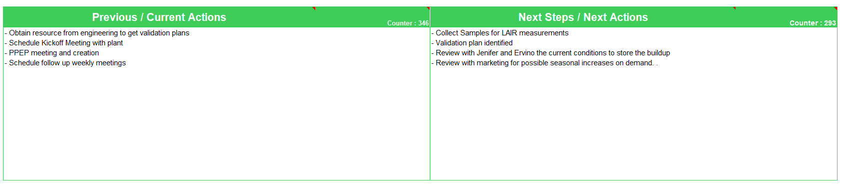
Status Report
Risks, Previous/Next Steps
A
A risk is an event that is likely to happen whereas an issue is something that has already happened.
B
Previous and Next Actions are only actions completed, as you only can report what is finished. It can be sync from Issues and Actions Log
Note: The period changes according to the "Frequency" that you insert in the cell C9.
It means that you should only report the previous/next actions according to your frequency.
A
Risk : Unforeseen event or activity that can impact the project's progress, result or outcome.
Identify risks, root-cause and consequence using supporting tools as Brainstorming, SWOT, Fishbone.
Risk Type : Choose how to respond to the risk, using probability and impact matrix to prioritize what get action.
Type of Risks : Avoid, Transfer, Accept, Mitigate, Exploit, Share, Enhance
Risk Action : The mitigation action taken for the immediate Risk.
Risks on status report can be sync with Risks tab
B
Prev/Next Actions: Use these fields for the periodic status report to indicate past/current or next actions

Slide 16
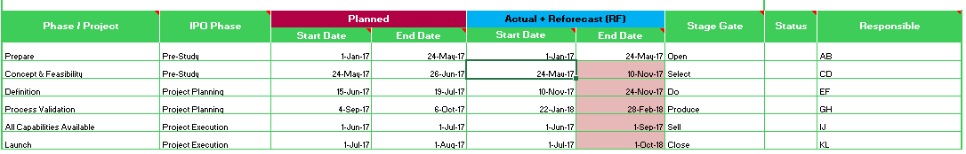

Status Report
Timelines
J
Option to load from the project plan is recommended as it is more detailed and automatic (avoid manual errors).
H
I
A
B
C
D
E
F
G
Minimum is 4 phases and maximum is 16 phases
A
Phase/Project
Collection of tasks/activities executed in a same period of time and reviewed at a future stage gate. If they are done, that means you can pass through the stage gate.
For very large projects with multiple Project Phases, e.g. Phase 1 China, Phase 2 EAJ etc, the PMP Phases in the template can be replaced.
Status
The status of the phase
G - Green – value measured is equal or greater than the goal/target.
A - Amber - value measured is below the goal/target, but can be recovered.
R - Red - value measured is below the goal/target and cannot be recovered.
F
Schneider Digital Phase
Leave it in blank. If there’s Schneider Digital involvement in your project, select the phases from droplist
Responsible: who is in charge to run the phase
B
G
H
Add Phase: Add new row for new phase
Remove phase: Remove selected cell phase
C
Planned
The planned dates should not be modified along the project, because it’s our first commitment. You can use the reforecast column.
!!!
I
Load Standard PMP Phases & Stage Gates: To help you to define the phase with the example of our PMP standard
D
Actual + Reforecast (RF)
Preferred Period Breakdown
Indicate whether the project milestones and progress charts should be broken down by week, month or quarter.
Notice that this button has an impact on the axis of the Gantt Chart.
Actual Start Date | Date that the phase actually started. If the phase hasn't started yet, then add the same date as the planned Start Date.
Actual End Date | Date that the phase actually finished. If the phase hasn't finished yet, then add the same date as the planned End Date.
J
E
Stage Gate
Stage Gate at the end of each phase. If more than one phases belong to the same stage gate, then you can enter the same stage gate multiple times.

Slide 17
Resource Plan
Document that determines the monthly resource breakdown, demand spikes of the resources assigned to the pre-study, project or program. Also determines roles and team sizing and will be useful when you need to proceed with your communication plan

Slide 18
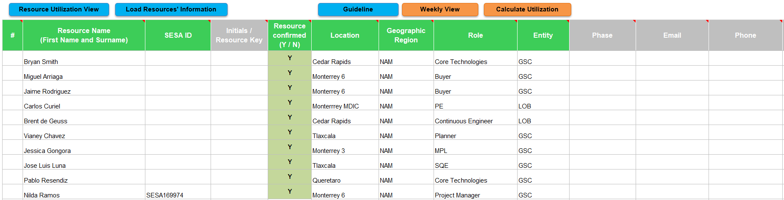
Resource Plan
Resource Table
There are mandatory and optional fields in this template. Mandatory fields are indicated in green header, while optional fields are indicated in grey header.
You can only pass through the “Do” stage gate when you have all your resources, i.e. project members and sponsor(s), defined and confirmed, otherwise you will lose time trying to find resources when the project should be already running!

Slide 19
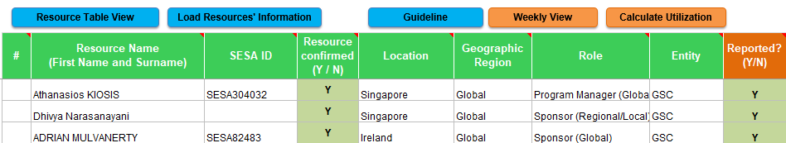
Resource Plan
Why is important to know your project member’s location and/or geographic region?
If your project members are not in the same location/region as you, you may take this into account when you communicate with them, schedule meetings and assign tasks within a timeline.
Resource Table : Mandatory Fields
Assign roles/ responsibilities will help you delegating tasks to your project members and also help them understand the reporting relationship among different stakeholders.
Column/Field | Description
Resource Name | If you don’t know who will be your project member, but know that he/she must come from a certain region, location or BU or you will need someone playing a certain role, enter: "Unknown“ or “TBC”.
SESA ID | Provide the SESA ID of each resource. If it is an external resource, you can leave it blank.
Resource Confirmed | Select "Y“, if the project member will be available to work within your project. "N“, if the project member name still to be determined or if the desired project member is still working or still need to finish his/her work in another project.
Location | Insert the city/country of the assigned project member. You can choose among the 25 cities from the drop down menu. If the intended location is not listed, you can also add a new location. If a project member hasn’t been identified yet, you can enter the likely or preferred location/country where you wish him/her to be based.
Geographic Region | You can choose among the 8 SE’s regions (Global, China, EAJ, Europe, IMEA, NAM, Pacific or SAM). If a project member hasn’t been identified yet, you can enter the likely or preferred geographic region where you wish him/her to be based.
Role | Insert your project member’s role/responsibility. You can choose among the 35 responsibilities in the drop down menu or add others that make sense in your reality. If a project member hasn’t been identified yet, you can enter the likely or preferred role/responsibility that you wish he/she to play
Entity | You can choose among the 3 main BUs in the drop down menu or add others that make sense in your reality. If a project member hasn’t been identified yet, you can enter the likely or preferred BU/entity you wish he/she to be based.

Slide 20
Project Schedule
Document that is used to guide the project execution and to track and control its progress.
The main objective is to document the tasks, action owners and time for each activity and facilitating the control of the project.

Slide 21

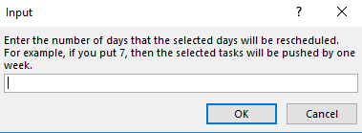
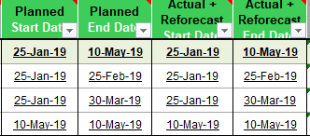

Update WBS is useful for MS Project exportation and dependencies.
Project Schedule
Schedule : Buttons
A
B
C
D
E
F
G
A
Update the status of a phase/task. If a phase/task is 100% completed, then the status will be updated to Blue [B], if a phase/task is 0% completed, then the status will ne updates to White [W].
G
The “Dependencies” button, automatically populates all the dependencies that exist in the Schedule and it directs you to Dependencies Worksheet in order to view them.
B
You automatically populates the WBS number for every Phase/Task/Subtask/Activity and save time from manually typing them.
F
If you want to change the dates of multiple tasks, then select the dates of those tasks, underline them and click the adjustment button. A new window will appear, you will enter the dates that you would like to push/pull your dates and click ok.
C
Task – Gantt mode allows the user to be able to view both tasks and Gantt chart in one view. It actually splits the screen with the tasks in the left side and the Gantt chart in the right side.
D
It automatically adjust the phase date, based on the changes that has been done in a task level. It takes the dates of the earliest start date and the latest end date of all tasks under that phase.
E
It updates the % of phase/task completion based on the time that has passed since the phase/task started. It doesn’t calculate the work effort.
The “Load PMP Schedule” button, loads the standard Stage Gates, phases, tasks and subtasks of the Project Management Process for Supply Chain projects.

Slide 22
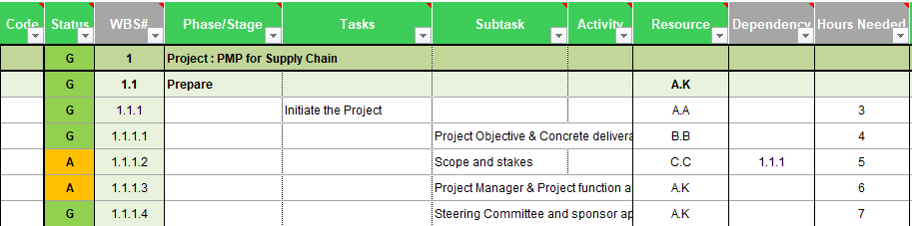
Project Schedule
Schedule Table
The status must be filled if you want to report the task.
Blue is automatic if 100% completed.
Green, Amber and Red are manual and defined by the PM.
Cells with gray background mean that the filling of the column is not mandatory.
Column/Field | Description
Code | The code is a keyword that is being used to consolidate multiple projects in one file. Use code to denote under which project each task is fall under.
WBS # | Is the number of the Work Breakdown Structure. It’s a way to better separate what needs to be done in levels / Work packages.
Phase/Stage Gate | Insert the Phase's name. For Stage Gate, follow the format: “Stage Gate: name of the stage gate“. E.g. Stage Gate : Open
Task | Description of the task that needs to be done in each Phase and Stage Gate.
Subtask | Description of the subtask (if there is) that needs to be done in each Task.
Activity | Description of the activity or work package (if there is) that needs to be done in each Subtask.
Resource | Insert the name or the initials of the person(s) responsible for the task.
Dependency | Insert the WBS number of the dependant Phase/Task/Subtask/Stage Gate. For more than one dependency, separate the WBS by comma and don’t add any space. Ex. 1.4,2.1.1,2,0.
Hours Needed | Insert the number of hours needed to complete the task.
If your task will last during different phases, it should appear in each of the phases but it will only be reported as a stage gate criteria at the end.

Slide 23
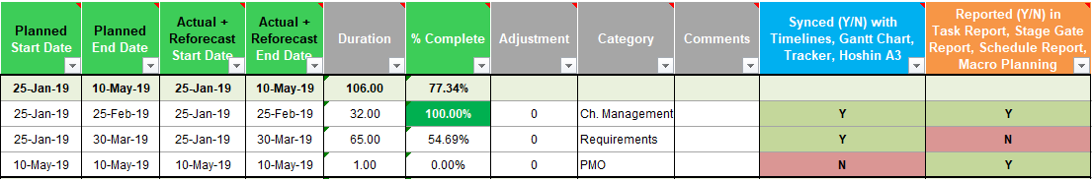
Project Schedule
Only tick “Y” in column “Appear in Stage Gate Report” if you are referring to a deliverable and not a normal task.
Schedule Table
Dates should only be inserted for the tasks, not for the phases, as they can be calculated automatically by pressing the button “Calculate phase dates”.
Column/Field | Description
Planned Start/End Date | Insert the estimate date that each task should start and finish.
Actual + Forecast Start /End Date | Insert the date that the task has actually started/ has been completed.
Duration | This field is automatic. It is the difference between the end date and start date in days.
% Complete | Percentage of completion of the task. You can either enter the values manually or automatically by clicking the “Update % Complete” button.
Adjustment | It shows the task's adjustment (in number of days). Refer to slide 40 for more information on the functions of the “Adjustment” button.
Category | Enter the name of the category that each task belongs to. The name of the category is mandatory in order to generate the Functional Planning Report.
Synced (Y/N) with Timelines, Gantt Chart, Tracker, Hoshin A3 | Insert “Y” if you want the deliverable to be synchronised with the Timelines, Gantt Chart, Tracker and Hoshin A3 templates.. Insert “N” if you don’t.
Reported (Y/N) in Task Report, Stage Gate Report, Schedule Report, Macro Planning | Insert “Y” if you want the deliverable to appear in the mentioned Reports.
Planned start and end dates are planning. They are our first commitment that should not evolve along the project. You don’t change these dates. What you can change is the “Actual + Reforecast Dates”, that is your reforecast. When the project starts the actual + reforecast dates are the same as the planned dates, but they can evolve and change during the project.
The % of completion that is calculated in project schedule, is based on time that has passed between today’s date and the start date of the task. For work-effort driven tasks, please do not use the button “Update % complete”

Slide 24
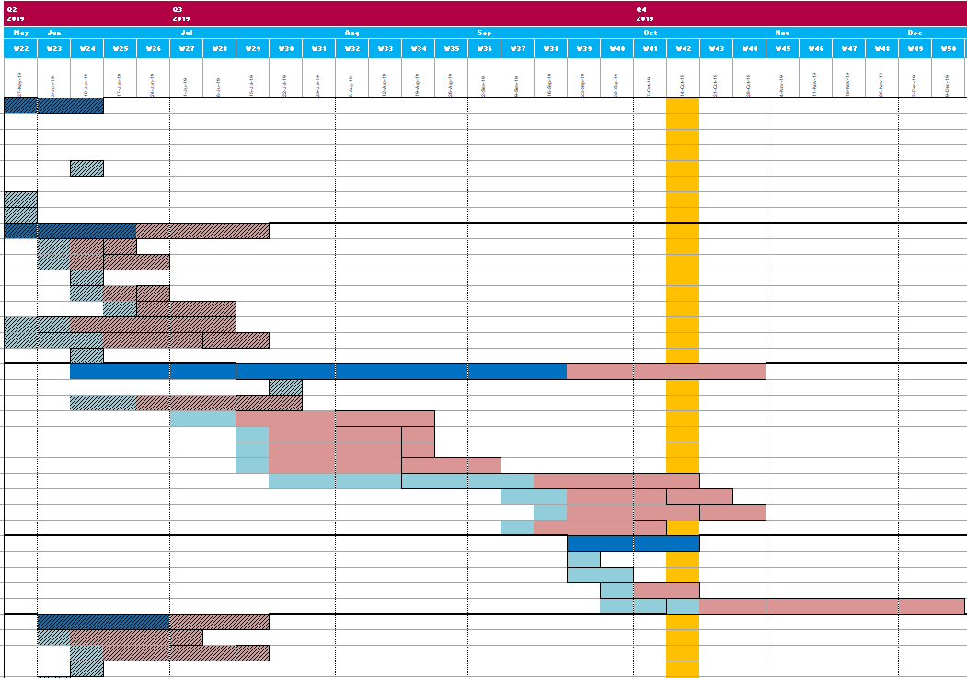

Project Schedule
Gantt Chart
Light Red : End date delay
Light Blue – No Border : Start Date Delay
Light Blue with pattern: Task is finished

Slide 25

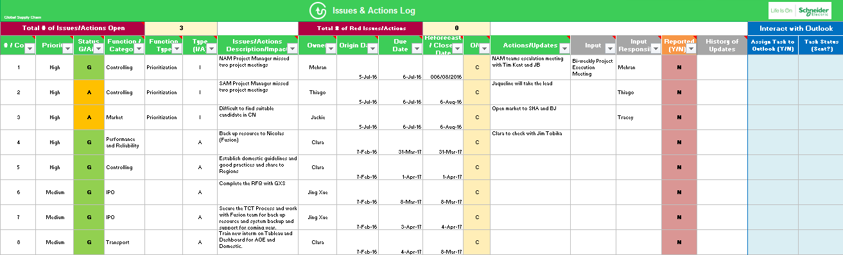
Issues and Action Log
Document that contains a list of ongoing and closed issues and actions of the project.
Raise Issue
Record Issue Resolution
Check Project Status
When an issue appears = analyze, prioritize and act on it as well as assign responsible
Register actions taken and issue’s impact on the project for future reference
Monitor project health and status after the issue’s occurrence
As an issue can happen no matter where you are in your project, the issues raising and solving flow is continuous during all phases and stage gates.
You should not pass to a next stage gate if you have a major issue that is not closed yet, unless it doesn’t affect any tasks of a future phase.

Slide 26
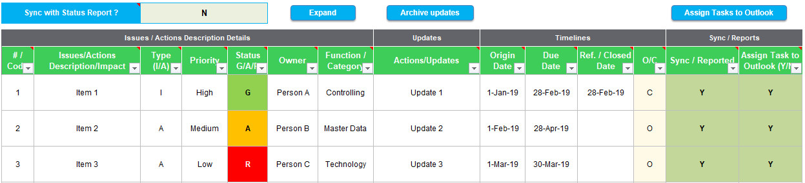


Issues and Action Log
Cells with gray background mean that the filling of the column is not mandatory.
Issues and Action Log Table
It is recommended to add the red issues with the highest impact to be reported.
Column | Description
#Code | The ID/Code of an issue or action. For multiple projects, it denotes the code of the project that the issue/action comes from.
Description / Impact | This field must be filled in order for the Issue/Action to appear in the Issues Report or Actions Report.
Type (I/A) | Insert if what are you reporting is an Issue or an Action. I stands for Issues and A stands for Action.
Priority | High - significant impact on timelines and quality of deliverables | Medium - moderate impact on timelines and quality of deliverables | Low - little impact on timelines and deliverables
Status G/A/R | Green (G): Action/Issue in progress and on track | Amber (A): Completion/resolution of action/issue at risk or delayed | Red (R): Action/Issue cannot be resolved or is significantly delayed.
Owner | Name of the responsible person(s) to whom the Issue/Action has been assigned to resolve.
Function / Category | Insert the function/category to classify and group similar issues. You can choose among the 27 functions/categories from the drop down menu or create new ones that make sense to your reality.
Actions/Updates | Insert the actions taken to resolve the issue and updates during the process.

Slide 27


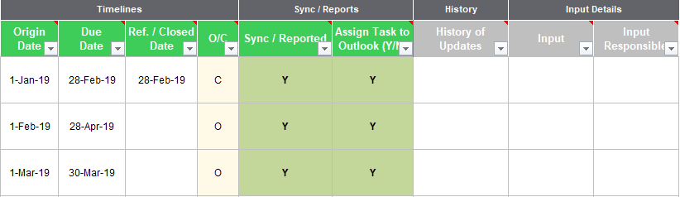
Issues and Action Log
Issues and Actions Log Table
A
B
C
A
Select “Y” to automatically synchronize the issues and actions with the Status Report.
B
Click the expand button to view the optional fields
C
Click the “Assign Tasks to Outlook” button in order to assign the selected tasks to the specified resource on Outlook
Column | Description
Origin / Due Date | Date that the Issue is being reported. As you should report an issue as soon as it happen, this date is the date that the issue/action has happened. The Due date is when the issue/action is expected to close.
Closed Date | Date that the issue/action has been solved and closed.
O/C | Insert the status of the issue/action: Open or Close. Entries without Closed date, cannot be closed.
Reported (Y/N)? | Insert “Yes” if you want the issue to appear in the Project Charter and Status Report. Insert “No” if you don’t.
Assign Task to outlook | To assign the task to respected to owner, select ‘Y’. Make sure that the owner’s name or email address is correct.
History of Updates | It shows the history of all of the updates that were inserted and archived. Click the button Archive Updates in order to view.
Input | Data needed to realize the action/issue?
Input Responsible | Who informed us about the action/issue?
Input Example
Action: measure on time delivery
Input: # of deliveries/daily
Input responsible: outbound transportation manager

Slide 28
Risk Register
Document in which the results of risk analysis and risk response planning are recorded.
Identify Risks
Risk Response
Assessment

Slide 29
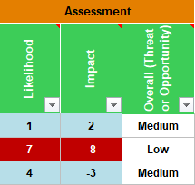
4.4 Optional Templates: Risk Register
Risk Register
Risk Assessment
Positive Impact = Opportunity
Likelihood Impact Type of Risk
0 - 5 0 - 5 Blue Zone - Guarded Risk
5 - 9 0 - 5 Yellow Zone - Elevated Risk
0 - 5 6 - 9 Orange Zone - High Risk
5 - 9 6 - 9 Red Zone - Exploit
Negative Impact = Threat
0 - 5 -5 - 0 Blue Zone - Guarded Risk
5 - 9 -5 - 0 Yellow Zone - Elevated Risk
0 - 5 -9 - 6 Orange Zone - High Risk
5 - 9 -9 - 6 Red Zone - Severe Risk
Negative Impact
Positive Impact
Column | Description
Likelihood & Impact | These two fields are the combination to evaluate the risk. You can insert a score of 1 to 9 in Likelihood column and -9 to 9 in Impact column. The numbers combined will result in a coloured cell. The colours combination can be found aside. This result will be reflected in the sheet “Risk Map Chart” according to the next judgment.
Overall (Threat or Opportunity) | Insert the size of the threat to the project: Low: cell colours are blue. Medium: cell colours are yellow or orange. High: cell colours are red.
-9
-1
0
1
9
High Risk
Low Risk
Low Risk
High Risk

Slide 30
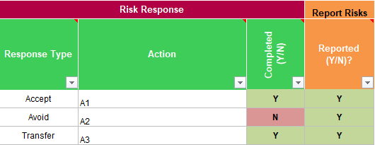
4.4 Optional Templates: Risk Register
Risk Register
Risk Response
Response Type for Positive/Negative Risks:
Avoid: Change project management plan to eliminate the possibility that the risk will occur.
Transfer: Shift the negative impact and responsibility for responding to a third party; e.g. insurance, vendor.
Mitigate: Develop and implement prevention and/or contingency plans.
Accept: Put on watch list, but take no further action. Fit for both, positive and negative risks.
Exploit: This parallels the ‘‘avoid’’ response, where the general approach is to eliminate uncertainty.
For opportunities, the ‘‘exploit’’ strategy seeks to make the opportunity definitely happen.
Share: It seeks a partner able to manage the opportunity, who can maximize the chance of it happening and/or increase the potential benefits.
Enhance: It seeks to increase the probability and/ or the impact of the opportunity in order to maximize the benefit to the project.
Negative Risks
Positive Risks

Slide 31
4.4 Optional Templates: Risk Register
Risk Register
Risk Register : Risk Response
Notice that only 3 columns from the Risk Register template will appear in the Status Report: Risk Event, Response Type and Action.
As only 6 risks can appear in the Project Charter and Status Report, it is recommended to add the risks that are in the red quadrant of the Risk Map Chart.
Column | Description
Response Type | Provide the response type by selecting the option from the drop down menu. (The records from this column will appear in the Status Report).
Action | Insert the action that will be taken to solve the risk. (The records from this column will appear in the Status Report).
Completed (Y/N) | Insert “Y” if the action has been completed, otherwise enter “N”.
Reported? | Insert “Yes” if you want the risk to appear in the Project Charter and Status Report. Insert “No” if you don’t.

Slide 32
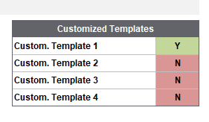
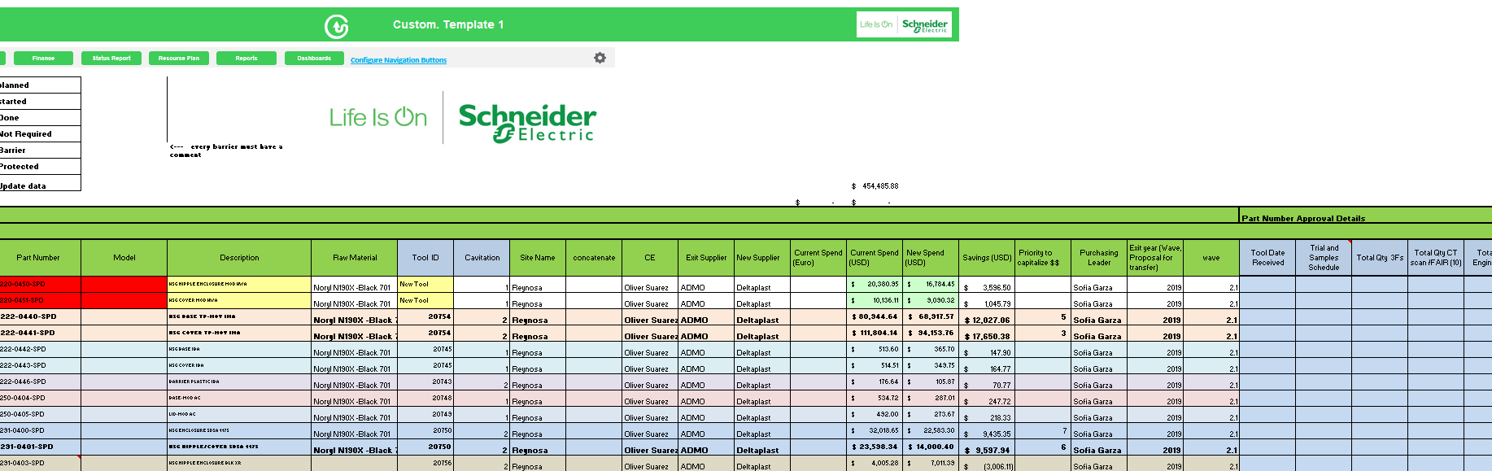

Customized Template
If you need some other templates that are not specified in GPS, you can create your own template with your own standard to be included in GPS. You can have up to 4 Customized List templates
You can modify the format freely as you wish

Slide 33
Live Demo
Let’s Play!

Slide 34

HOW TO MIGRATE GPS INFORMATION TO PPT?

Slide 35
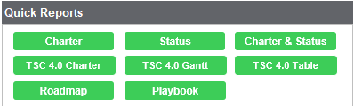
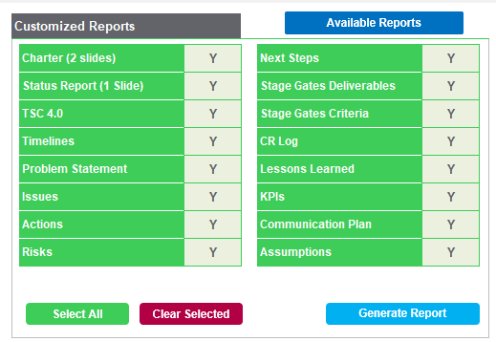
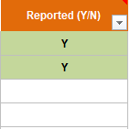
Reports
Report options
There are 2 options to generate the reports to analyze the project’s status: by clicking in one of the buttons of Quick Reports (1) or by customizing your report and clicking the “Generate Report Button” (2)
1
2
If you chose to have a customized report, you have to select which report you want to include in the PowerPoint Deck, by selecting “Y” or “N” next to the template’s name. e.g. If you wish to generate the Risk Report, then select “Y” after “Risks” field.
If you want to have a customized report you have to fill the information in their specific templates (e.g, Risk Register) and don’t forget to select “Y” (in capital letter) in order to indicate which records will appear in the PowerPoint reports.

Slide 36
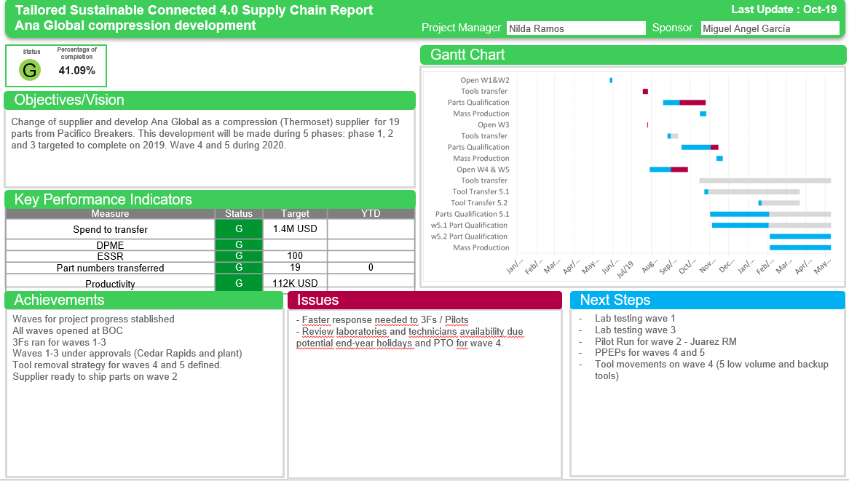
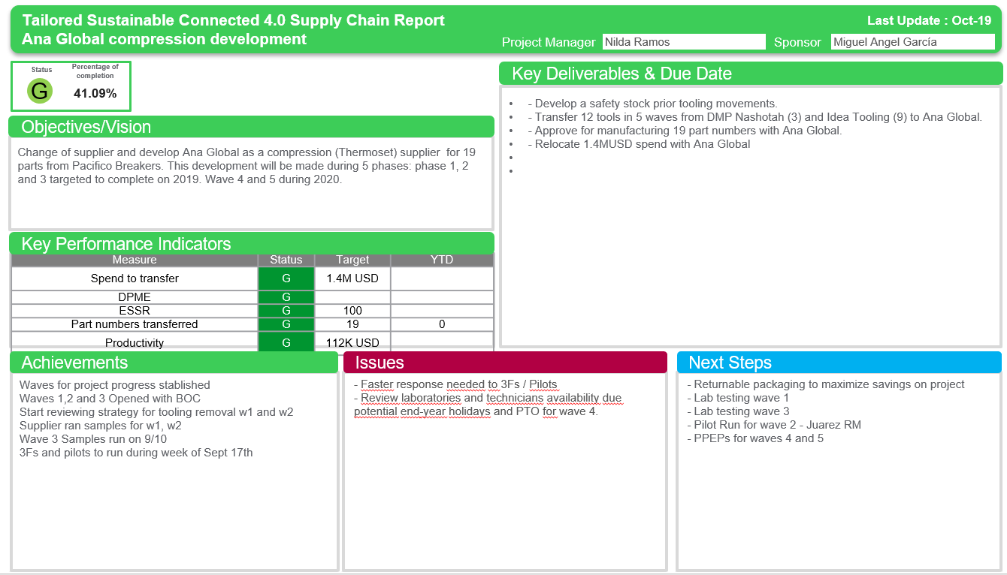
Reports5. Reports: TSC4.0 Status Report
TSC 4.0 Status Report
What it is and how it looks like
The TSC4.0 Report is a key document that supports the Tailored, Sustainable and Connected 4.0 reporting format.
Example of
TSC4.0 Status Gantt Report
Example of
TSC4.0 Status Table Report
Charter:
  Objective;
  Key Deliverables;
Status Report:
  KPIs, Key Indicators
  Achievements
  Issues
  Next Steps
  Timelines
The blue line shows the phase’s planned date and the red one the phase’s reforecast.
The red line also shows how much the project is delayed.
Inputs

Slide 37
Questions?

Slide 38
Notes:
Closing slide

